Slide 1
EASY VISA
An optimization problem | 15-Dec-2025
By Uday Poluri

Slide 2
Contents / Agenda
Executive Summary
Business Problem Overview and Solution Approach
EDA Results
Data Preprocessing
Model Performance Summary
Appendix

Slide 3
Executive Summary
The goal of this project was to develop a robust machine learning classifier to predict the visa application outcomes and identify the drivers for approvals. By automating the initial screening process, the model significantly reduces the manual effort and enhances the operational efficiency.
Methodology & Development
Benchmarking: A baseline is established with default models, followed by the development of advanced ensemble models for robust predictions.
Data processing: Implemented Class Imbalance mitigation to balance the output classes and eliminate bias towards under-represented class.
Hyperparameter Tuning: Applied optimization techniques to tune the model and maximize the performance.
Model Evaluation and Performance:
The goal is to minimize False Positives ( a wrong person getting the position) and False Negatives (Will miss a qualified resource)

Slide 4
Executive Summary
Model Evaluation and Performance (Continued):
Gradient Boosting Classifier achieved the best F1 Score of 0.82 indicating a balance between Recall (False Negatives / missed qualified resources) and Precision (False Positives / incorrect approvals).
The model achieved a high Recall (~89%) on the positive class, successfully identifying vast majority of qualifying applications.
~26% of applications were predicted incorrectly, however the performance was consistent across the Training, Validation and Test data indicating that model was generalizing well.
Key Insights and Drivers
Employee education, Prevailing wages and Job experience are top features influencing the decision.
Higher education, higher prevailing wages and prior job experience all show a strong positive correlation with approval ratings.
Applications from Europe region show highest approval rates relative to their volume, while South America recorded the lowest approval rates.

Slide 5
Business Problem Overview and Solution Approach
Business Problem
The US Immigration and Nationality Act (INA) allows US employers to hire foreign workers on both temporary and permanent visa bases. To do so, the employers must file job certification applications seeking approvals from Office of Foreign Labor Certification (OLFC).
The volume of these job applications is increasing significantly year over year making the manual review increasingly ineffective and tedious.
Objective
To develop a data driven solution that streamlines the process by identifying the applications with higher chance of approvals.
The solution will enable OLFC to prioritize review efforts efficiently and significantly reduce manual processing time.
Solution Approach
Exploratory
Data Analysis
Data Modeling
& Fine tuning
Actionable
Insights
Monitoring &
Value assessment
Data gathering
Cleaning
Feature engineering
Understanding patterns and insights
Machine Learning modeling
Data validation
Optimize model for better performance
Case Drivers
Process improvements
Monitor model performance
ROI measurement
Improve and iterate

Slide 6
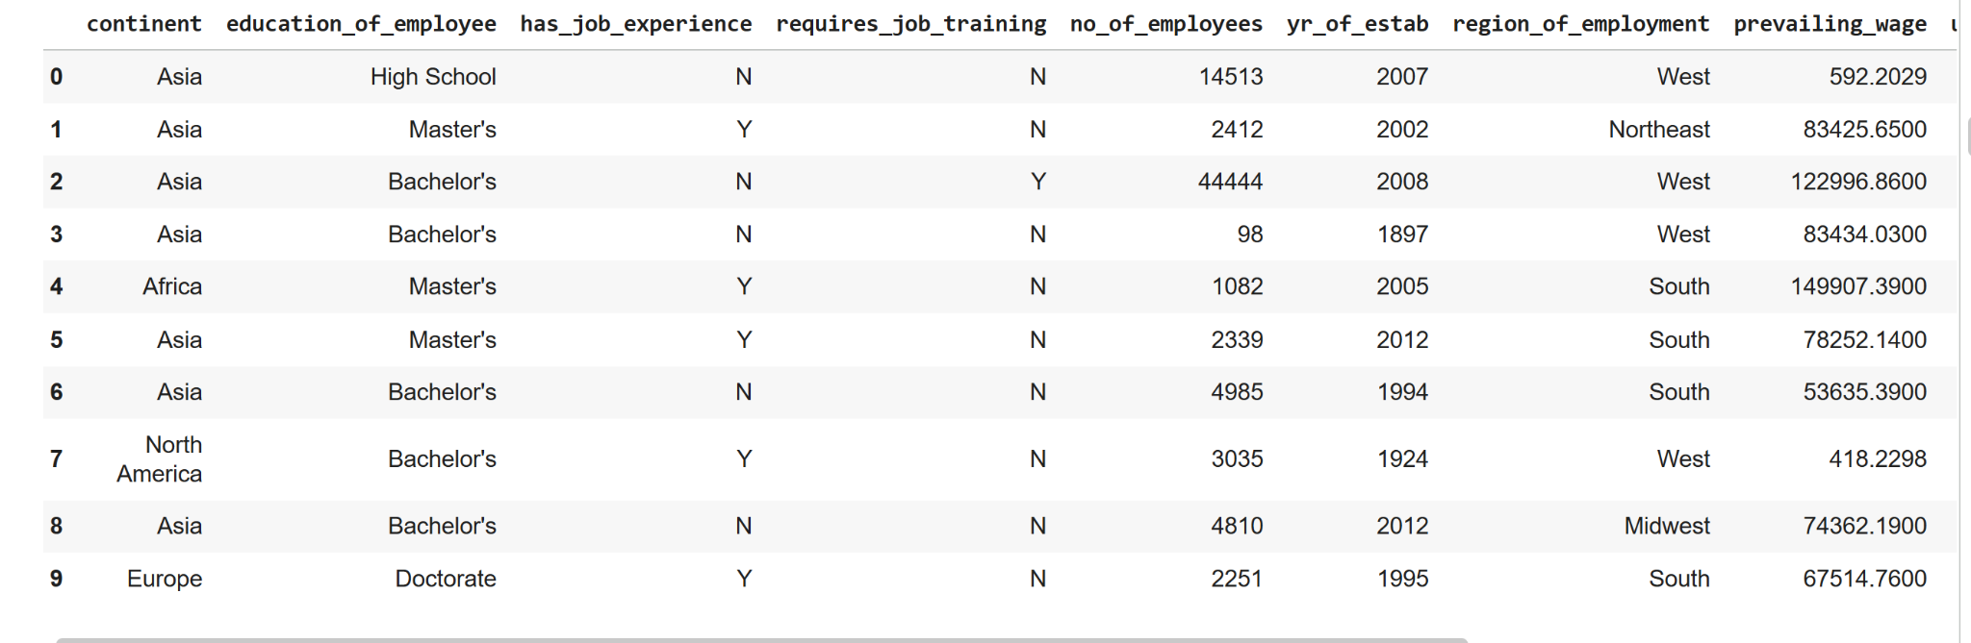
Data Overview
25,480 applications
5 regions of employment
Applications from 5 continents and Oceania region
66.8% of certified applications.
Data Source
EasyVisa.csv
Size of the Data
25,480 rows | 12 cols
Online orders made by Foodhub customers

Slide 7
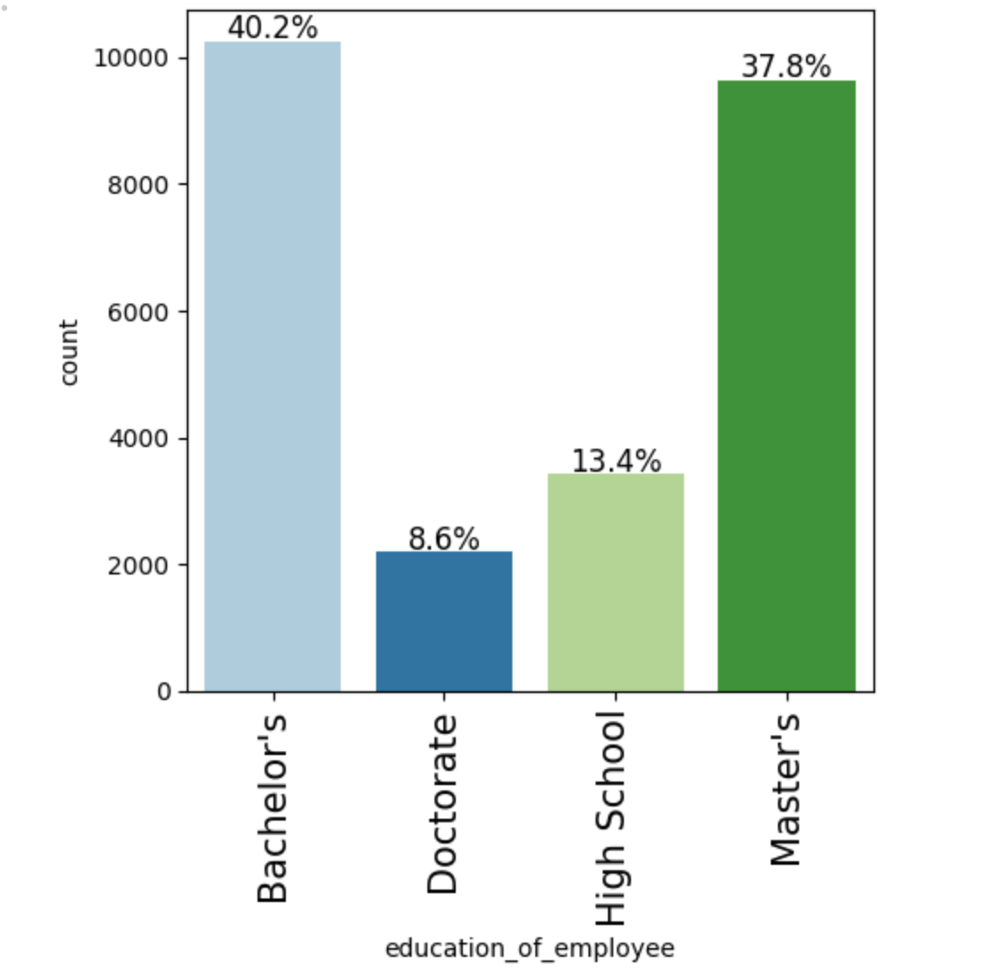
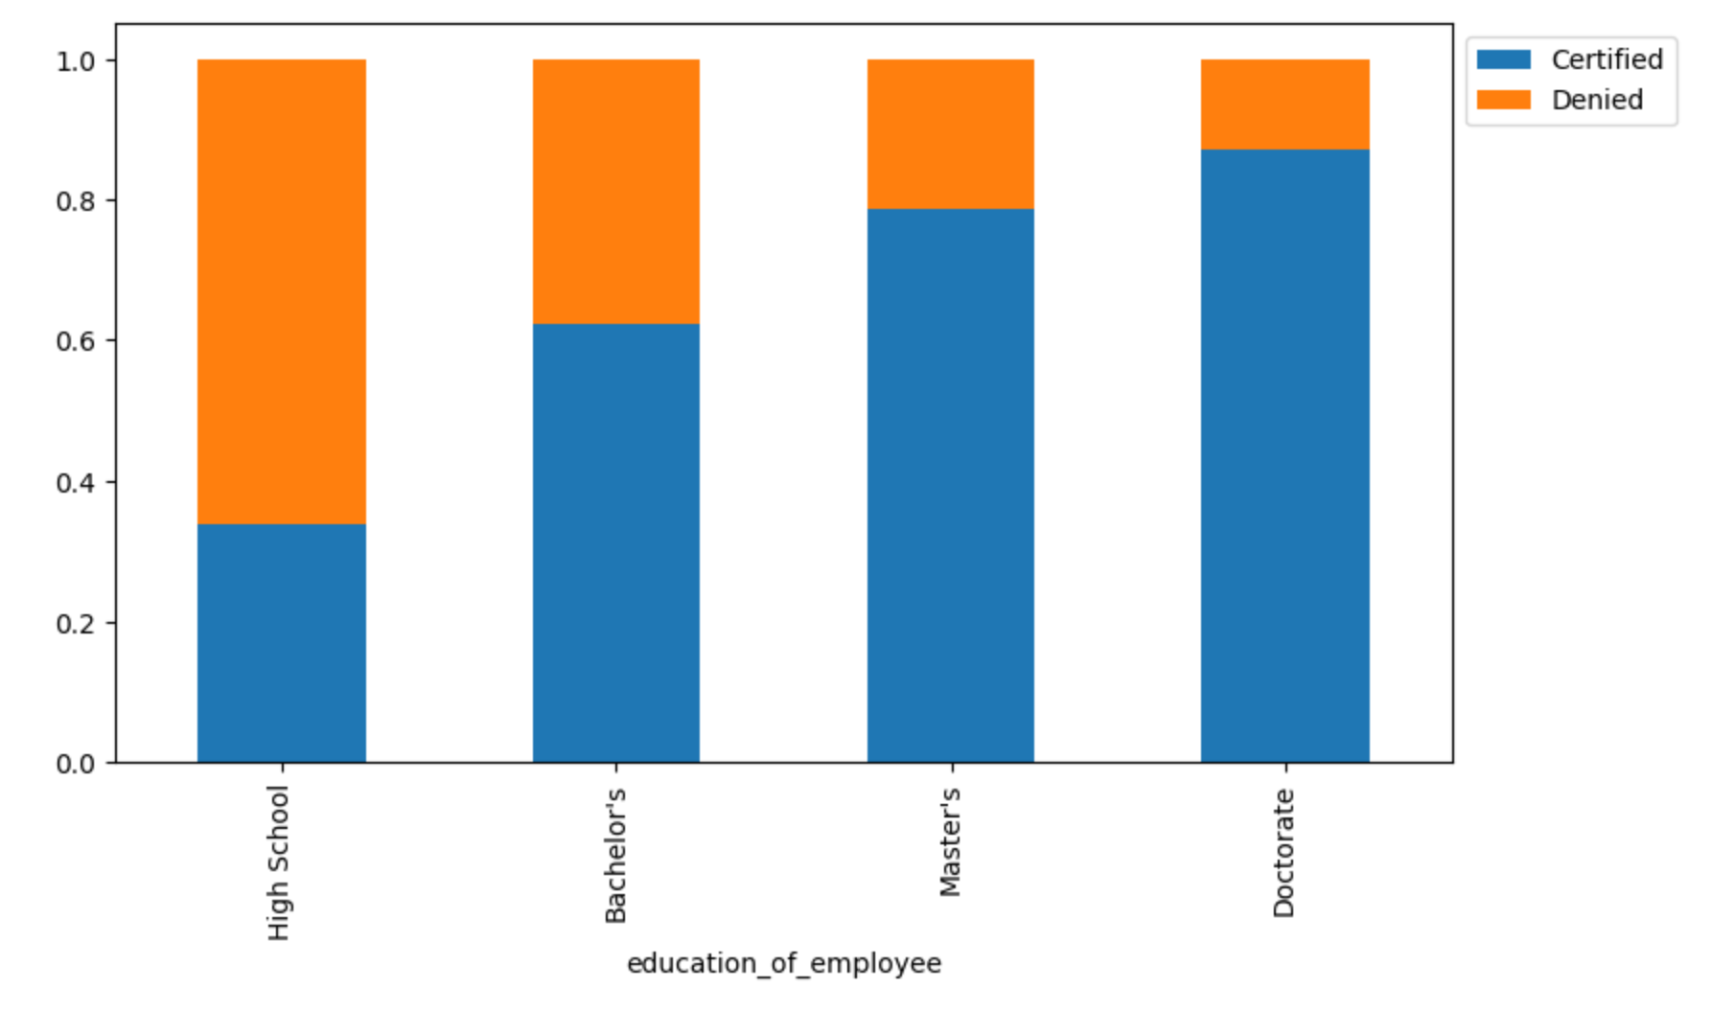
EDA : Applicants Education
Education level demonstrates a strong positive correlation with application approval rates.
Specifically, 85% of doctorate-level applications and 80% of master's-level applications have received approvals.
Nearly 87% of applicants hold a Bachelor's degree or higher educational qualification.
The remaining 13% of applicants possess a high school education

Slide 8
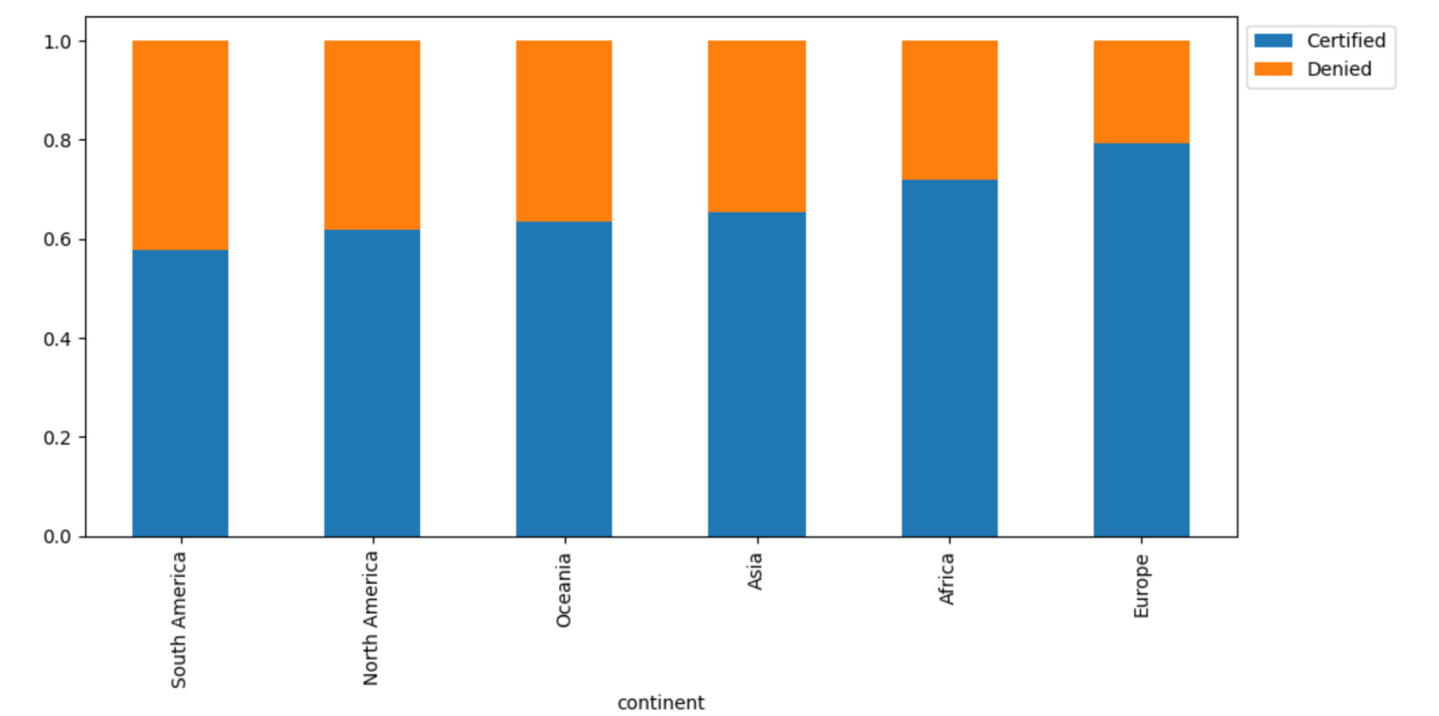
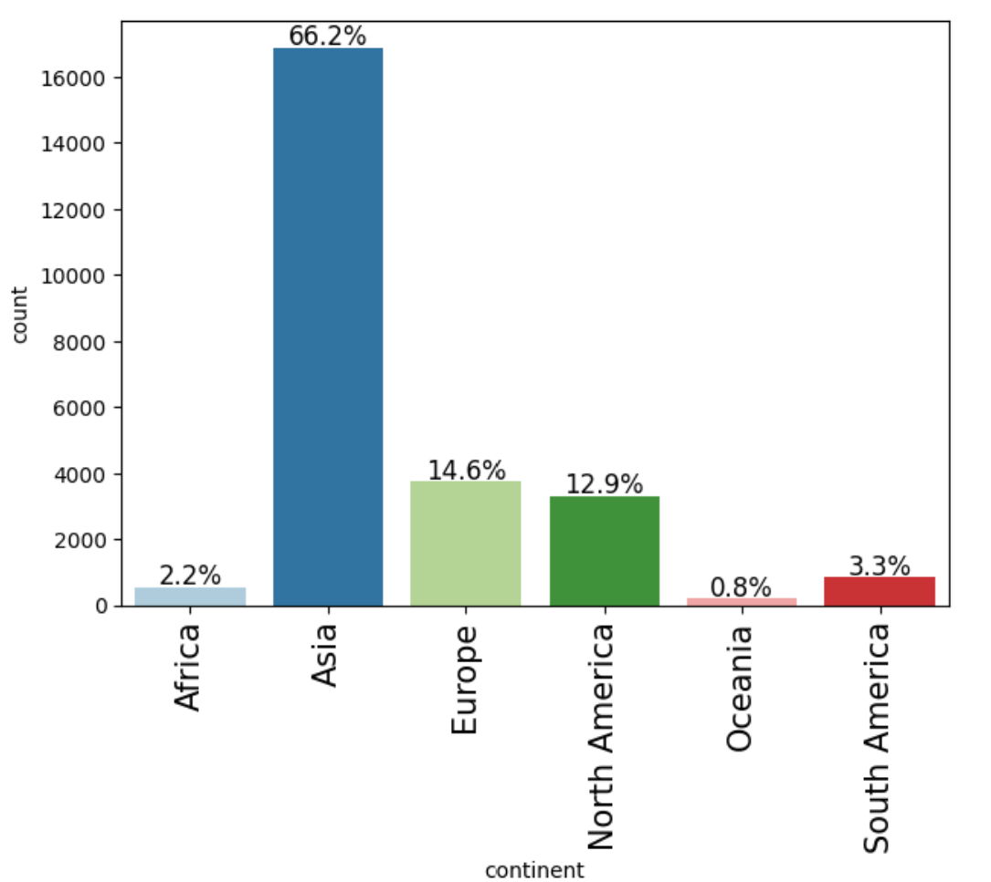
EDA : Applicant’s Continent
Nearly 80% of applications from Europe are approved.
South America records the lowest approval rate across all continents, at 58%.
A significant (66%) majority of the applications are from Asia.

Slide 9
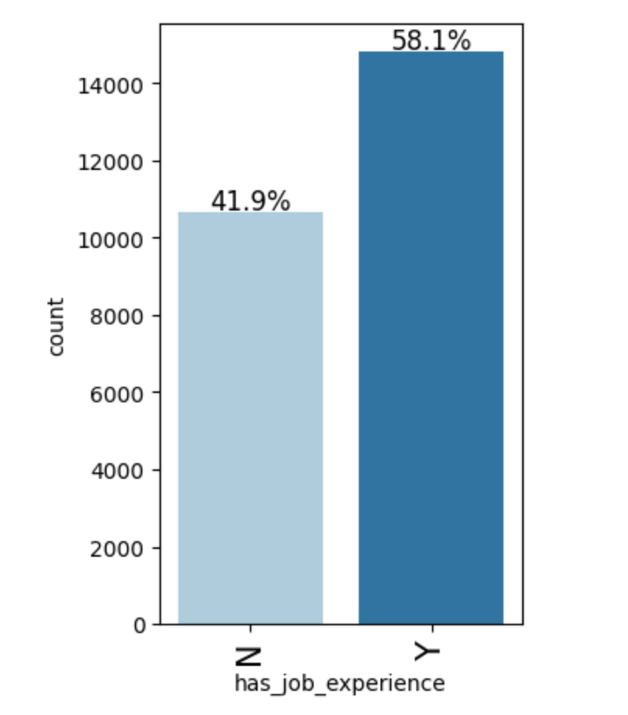
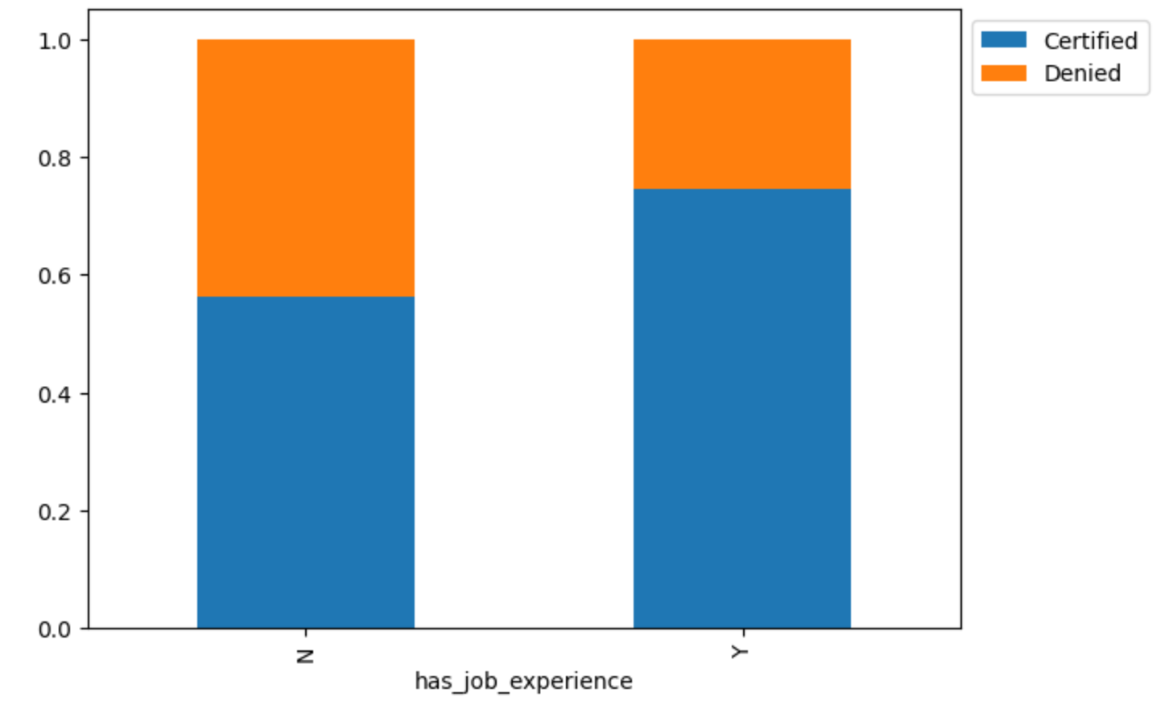
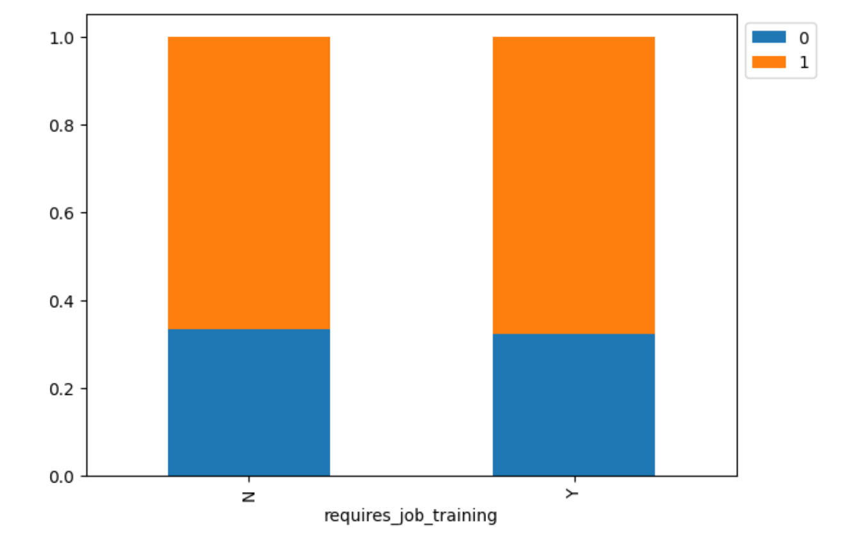
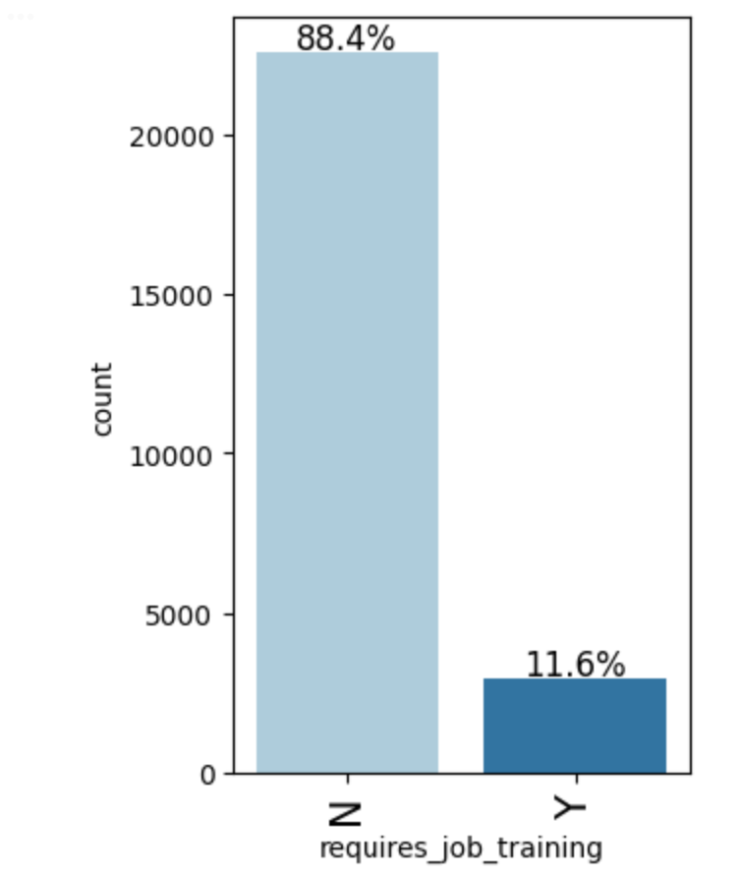
EDA : Applicants Experience & Training requirement
Forty-two percent of candidates reported having no prior job experience.
Applicants who do possess relevant job experience exhibit higher approval rates.
Twelve percent of applicants indicate a requirement for job training.
Approval rates remain similar for these applicants compared to those who do not require training.

Slide 10
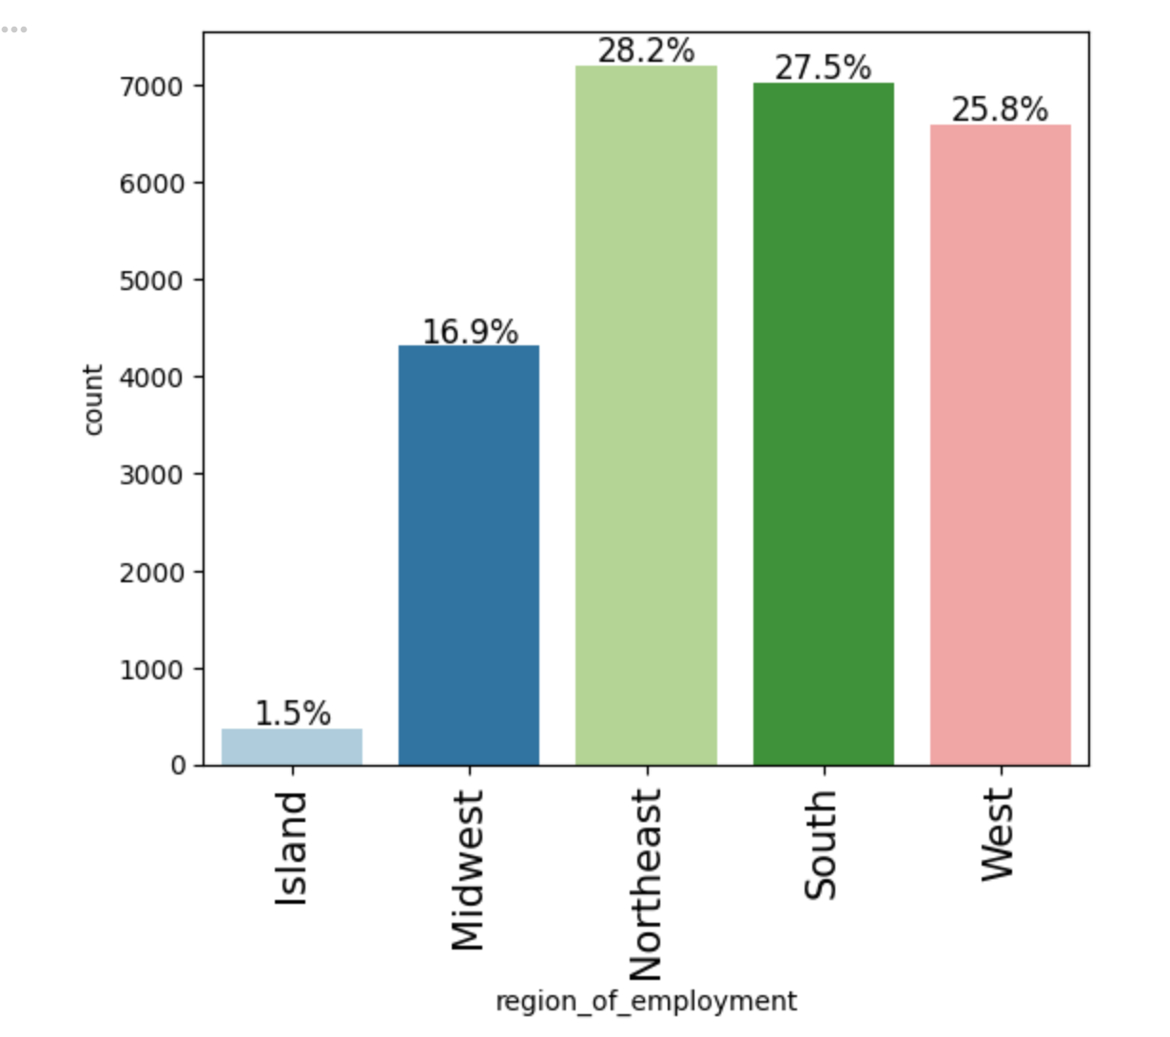
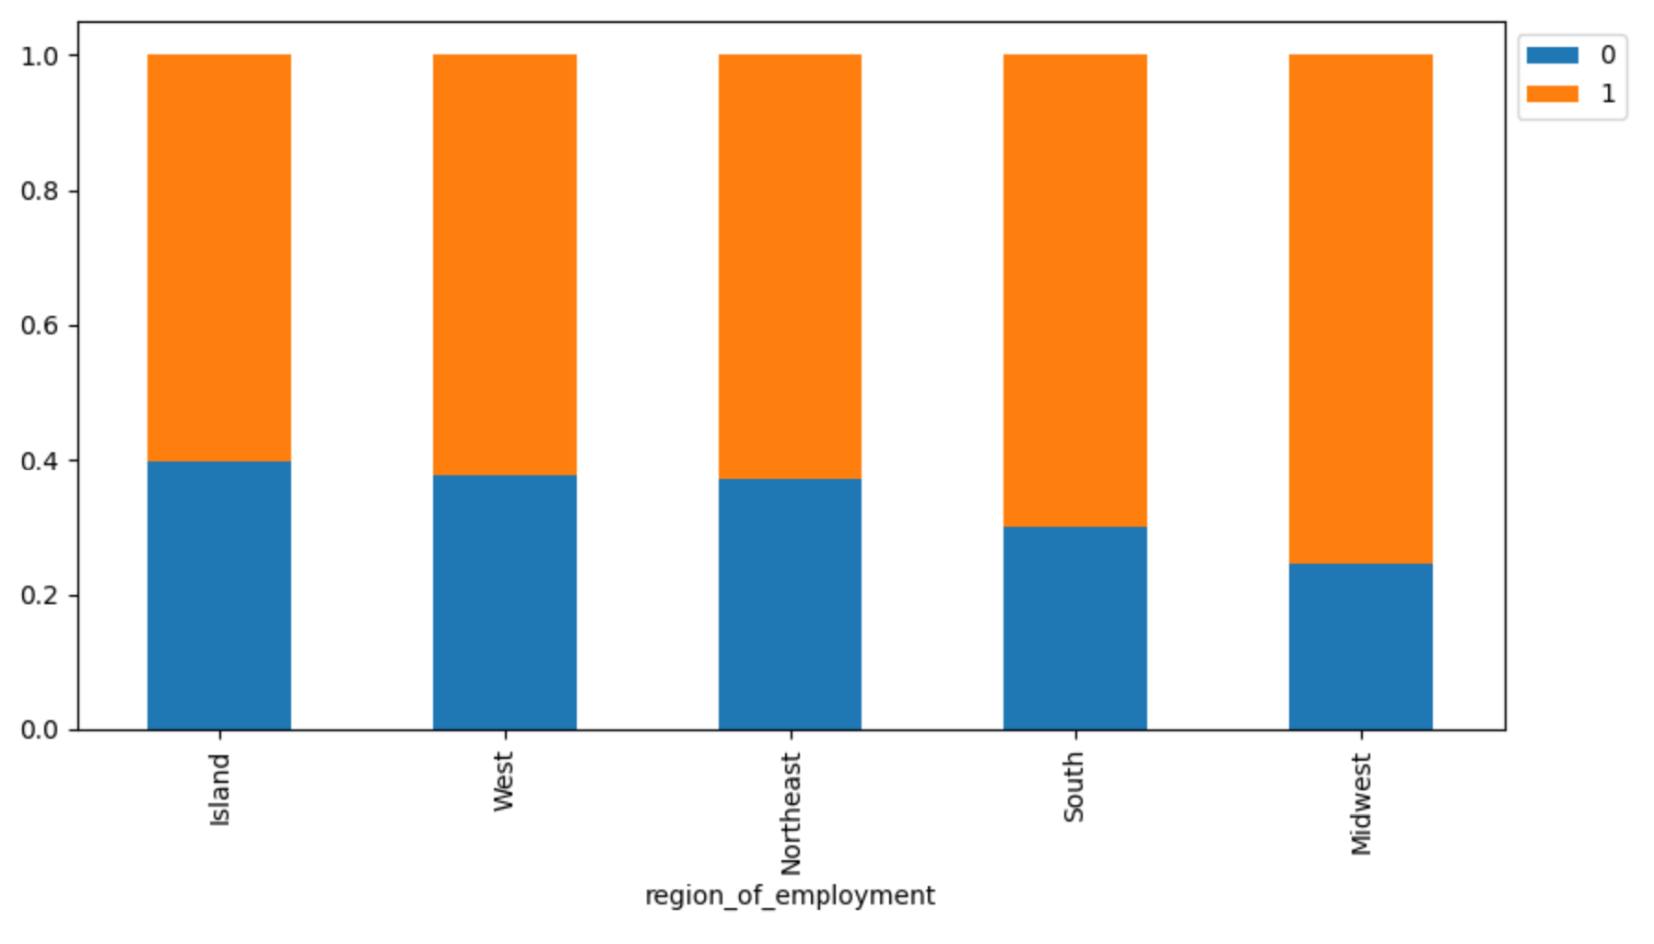
EDA : Company’s Region of employment
North east has the highest employment for foreign workers.
In mainland US, midwest has the least employment for foreign workers.
Midwest has the higher approvals compared to other regions in US.

Slide 11
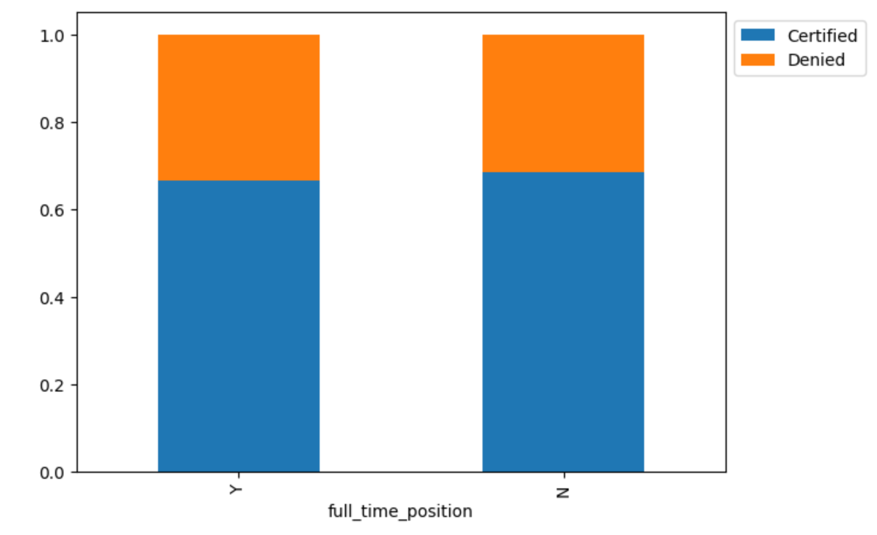
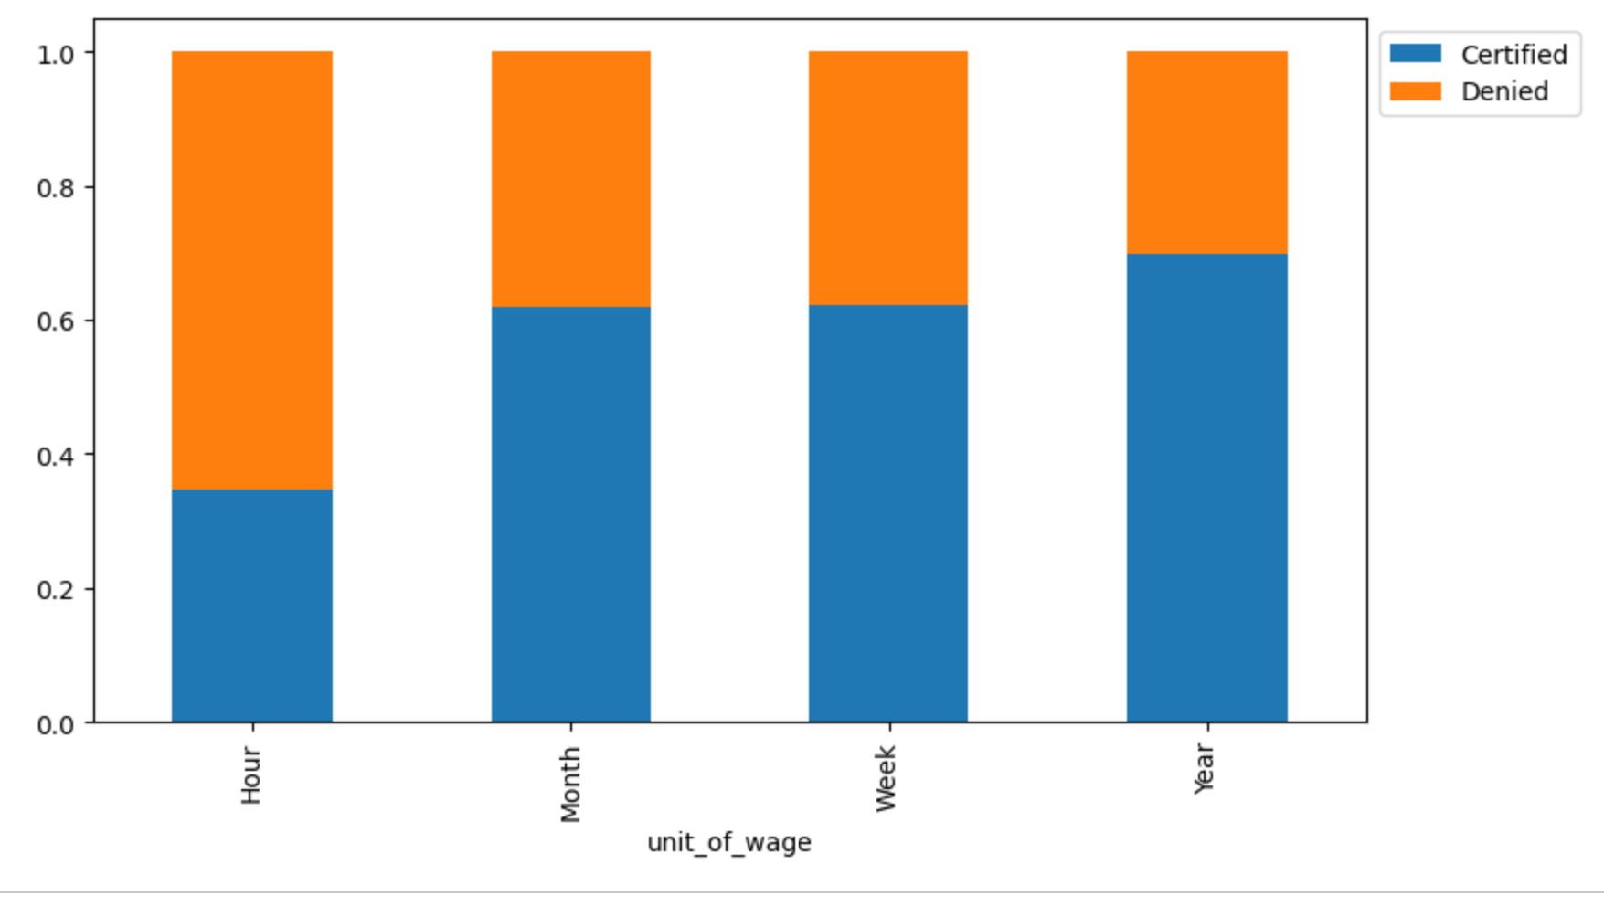
EDA : Job and Wage type
Sixty five percent of the positions are approved in both full and part time positions, indicating an identical approvals.
Jobs with annual wages are highest approved compared to other wage types.

Slide 12
EDA : Summary
Demographics and Geography
A significant majority (66%) of all applications originate from Asia.
Ninety-nine percent of job applications are from the continental U.S. Within the mainland U.S., the Northeast region submits the highest volume of applications, while the Midwest submits the lowest.
Approval rates vary geographically: The Europe region exhibits the highest visa approval rate overall, whereas South America reports the lowest approval rate across all continents.
Midwest Approval Anomaly: Despite having the lowest application volume in the U.S., the Midwest region demonstrates higher approval rates compared to other U.S. regions.
Education and Experience
Applicant education level shows a strong positive correlation with visa approval rates. More than 80% of both doctorate-level and master's-level applications receive approvals.
Prior job experience is a strong indicator of approval. Applicants who possess relevant job experience consistently receive higher approval ratings than those without experience.
Job Details and Requirements
Wage Type Matters: Applications listing annual wages have the highest approval rates compared to those with other wage structures (e.g., hourly wages).
Position Type is Neutral: Approval rates are identical between full-time and part-time positions.
Training Not a Factor: While a majority of applicants do not require job training, the approval rating is identical for applicants who require training and those who do not.

Slide 13
Data Preprocessing
Duplicate check: No duplicate rows are present in the training data.
Missing value check: Training data has no missing values.
Outlier Detection: The ‘number of employees’, ‘year of establishment’, and ‘prevailing wage’ features have outliers, however given the variability in the data set, these values are expected. Therefore no outliers treatment is performed.
Feature Engineering: is the process to transform the raw data into features that help machine learning algorithm perform better.
No new features are created.
Data transformed to handle the categorical features.

Slide 14
Data Preprocessing
Data preparation for modeling:
Encoding: Following categorical features are encoded using pandas get dummies function with drop_first option.
Continent
Education of Employee
Has job experience
Requires job training
Region of employment
Unit of wage
Full time position
Data Split:
Data is split into three sets using stratify- train, validation and test
Stratify ensures the proportion of target class in each of train, validation and test data sets are maintained.
train set is used for model training.
validation set is used for hyper parameter turning to improve the model performance.
test set is used to evaluate the final model performance.

Slide 15
Methodology: Modeling, Optimization, and Evaluation
Evaluation
Criteria
Data Preparation
Baseline Modeling (Default Parameters)
Class
Imbalance Mitigation
Ensemble Modeling
Hyperparameter Tuning
Final Model Selection
Feature Importance & Interpretation

Slide 16


Model Evaluation Criteria
Model Predictions:
Model predicts that visa application will get certified but in reality, the visa application should get certified.
Model predicts that the visa application will get certified but in reality, the visa application should get denied.
Model predicts that the visa application will not get certified but in reality, the visa application should get certified.
Model predicts that the visa application will not get certified but in reality, the visa application should get denied.
False Positive
Important, otherwise a wrong person will get the position or US will lose a qualified resource
False Negative
We will use “F1 Score” to evaluate the model performance, a higher score will minimizes the chances of False Positives and False Negatives

Slide 17
Model Performance: Base line (Default Parameters)
Model | F1 Score |  | Observation
 | Training | Validation
Bagging Classifier | 0.9891 | 0.7736 | Overfitting
Random Forest Classifier | 1.0 | 0.8049 | Overfitting
AdaBoost Classifier | 0.8204 | 0.8180 | Generalizing well.
Gradient Boost Classifier | 0.8291 | 0.8266 | Generalizing well.
XGBoost Classifier | 0.8963 | 0.8079 | Overfitting
AdaBoost and Gradient Boost Classifiers are generalizing well, with a fairly good F1 score of 0.82.
Bagging, Random Forest and XGBoost classifier models did well on training data, but not so good on validation data indicating a overfit scenario.

Slide 18
Model Performance: Class Oversampling - Default Parameters
Model | F1 Score |  | Observation
 | Training | Validation
Bagging Classifier | 0.9875 | 0.7665 | Overfitting
Random Forest Classifier | 0.9999 | 0.7965 | Overfitting
AdaBoost Classifier | 0.8005 | 0.8195 | Generalizing well.
Gradient Boost Classifier | 0.8072 | 0.8173 | Generalizing well.
XGBoost Classifier | 0.8708 | 0.8129 | Overfitting
AdaBoost and Gradient Boost Classifiers are generalizing well, with a decent F1 score of 0.81, but it is slightly lower than without Class Oversampling.
Bagging, Random Forest and XGBoost classifier models did well on training data, but not so good on validation data indicating a overfit scenario.

Slide 19
Model Performance: Class Undersampling - Default Parameters
Model | F1 Score |  | Observation
 | Training | Validation
Bagging Classifier | 0.9803 | 0.7057 | Overfitting
Random Forest Classifier | 1.0 | 0.7417 | Overfitting
AdaBoost Classifier | 0.7015 | 0.76599 | Underfitting
Gradient Boost Classifier | 0.7281 | 0.7765 | Underfitting
XGBoost Classifier | 0.8720 | 0.7459 | Overfitting
AdaBoost and Gradient Boost Classifiers did better on validation data, but are making lot more mistakes in prediction.
Bagging, Random Forest and XGBoost classifiers did well on training, but performed poorly on validation data indicating the overfitting.

Slide 20
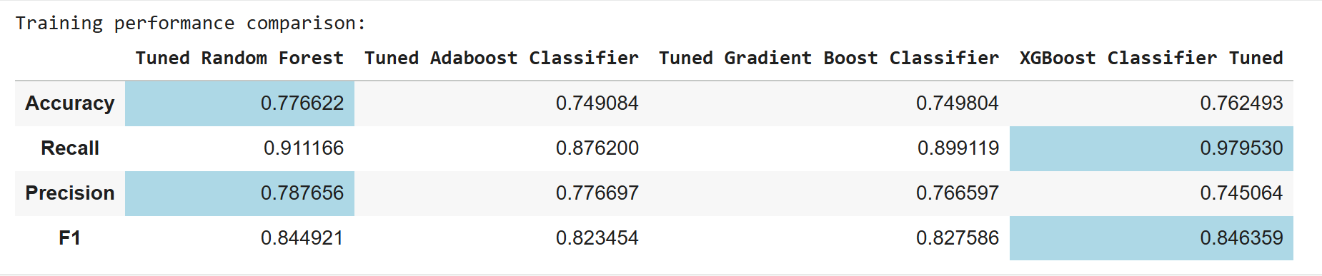
Tuned Model Performance - Training Data
Random Forest and XGBoost Classifiers have the best F1 score on training data.
Random Forest has the highest Precision score, ie. lower False Positives
XGBoost Classifier has the highest Recall score, ie. lower False Negatives.

Slide 21
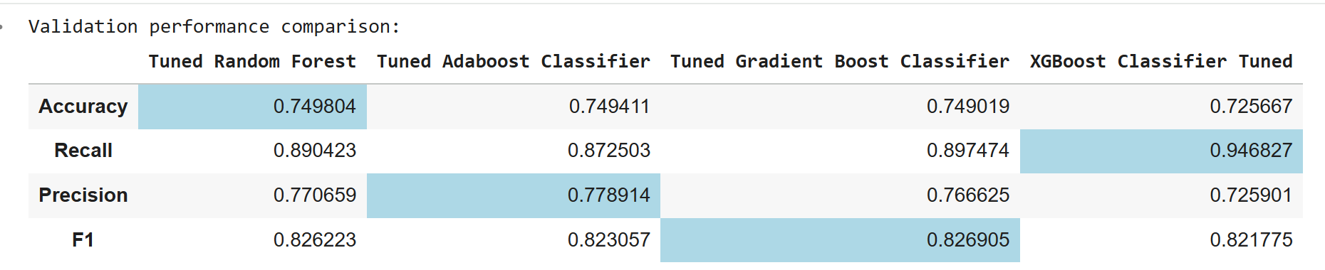
Tuned Model Performance - Validation Data
Gradient Boost Classifier has the best F1 score indicating lower False positives and False negatives.
Also Gradient Boost Classifier is generalizing well with similar F1 scores between Training and Validation data.

Slide 22
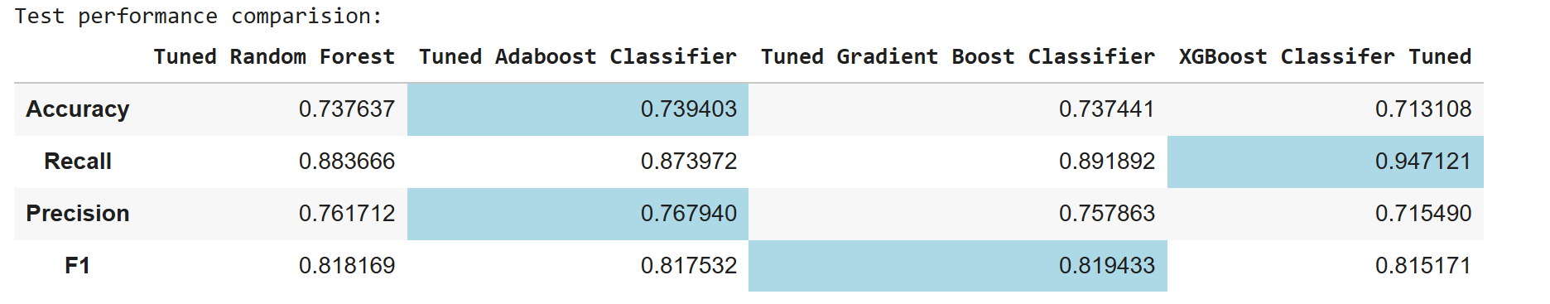
Tuned Model Performance - Test Data
Gradient Boost Classifier has the best F1 score indicating lower False positives and False negatives.
Overall tuned Gradient Boost Classifier is generalizing well, with similar F1 scores between Training, Validation and Test data.

Slide 23
Model Performance Summary and Final Model Selection
AdaBoost Classifier and Graident Boost Classifiers performed well with default parameters.
Class Imbalance techniques such as SMOTE oversampling and RandomUnderSampling have not resulted in model performance improvements.
Hyper parameter tuning has improved the overall model performance by reducing the overfitting, ie a similar F1 score is observed across Training, Validation and Test data sets.
Tuned Gradient Boost Classifier and XGBoost Classifier have the best F1 scores, however XGBoost is slightly overfitting the training data.
Based on the observed F1 scores across Training, Validation and Test datasets, We choose Tuned Gradient Boost Classifier as the final model.

Slide 24
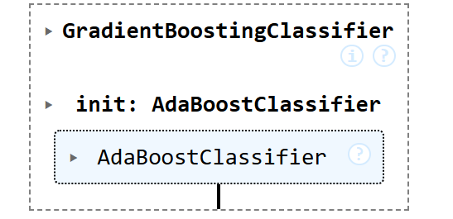
Final Model
Hyperparameters:
"n_estimators": np.arange(50,110,25),
"subsample": [0.7,0.9],
"max_features": [0.7, 0.8, 0.9, 1],
"learning_rate": [0.01,0.1,0.05],
Model tuning is performed by Grid Search Cross validation with cv=5 folds
Model is tuned by fitting 5 folds for each of 72 candidates, totalling 360 fits

Slide 25
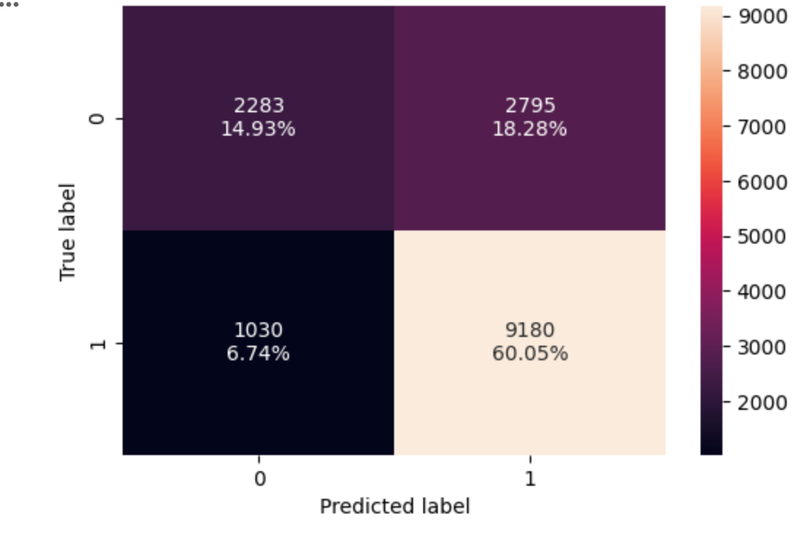
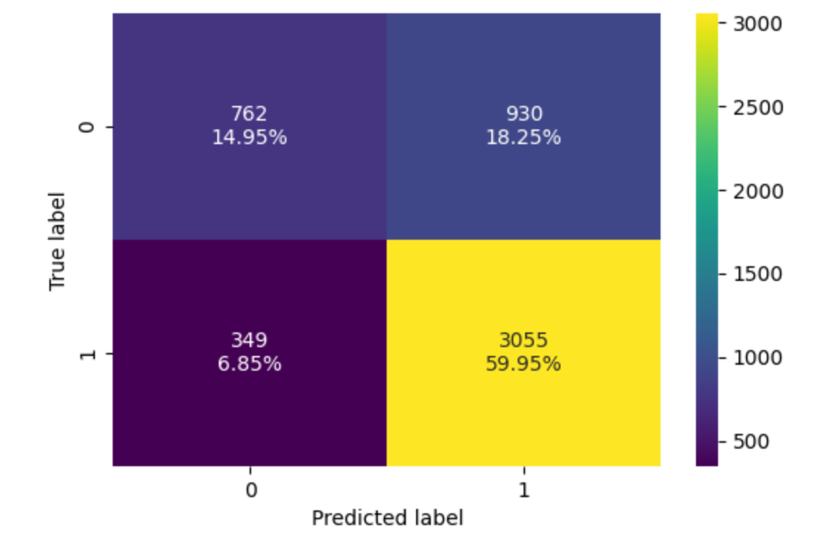
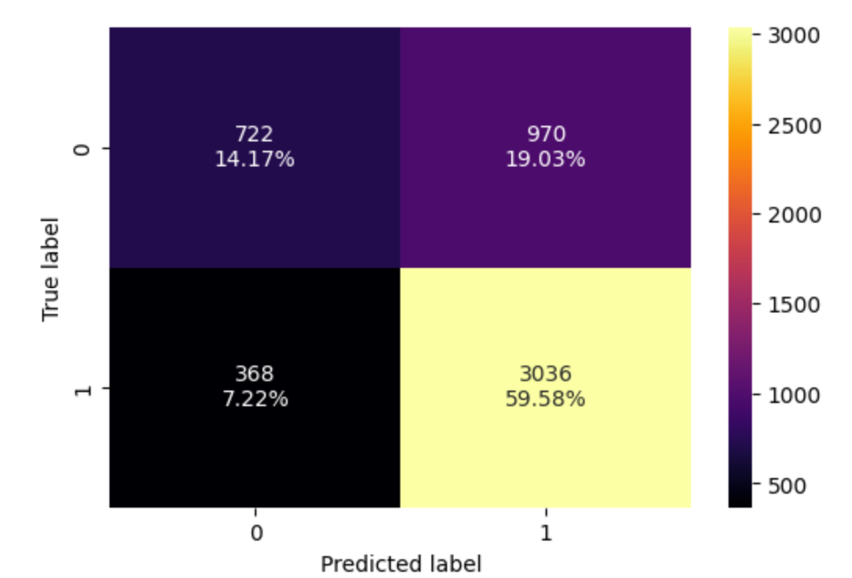
Final Model : Gradient Boosting Classifier Performance
Confusion matrix on Training Data
Confusion matrix on Validation Data
Confusion matrix on Test Data
~26% of the applications are predicted incorrectly across the data sets.
~7% of applications were False Negatives (Missed approvals)
~18% of applications were False Positives (Incorrectly reviewed)
The performance is identical across the data sets, indicating a fairly well generalized model.
The model achieves a high Recall (~89%) on the positive class, successfully identifying vast majority of qualifying applications.

Slide 26
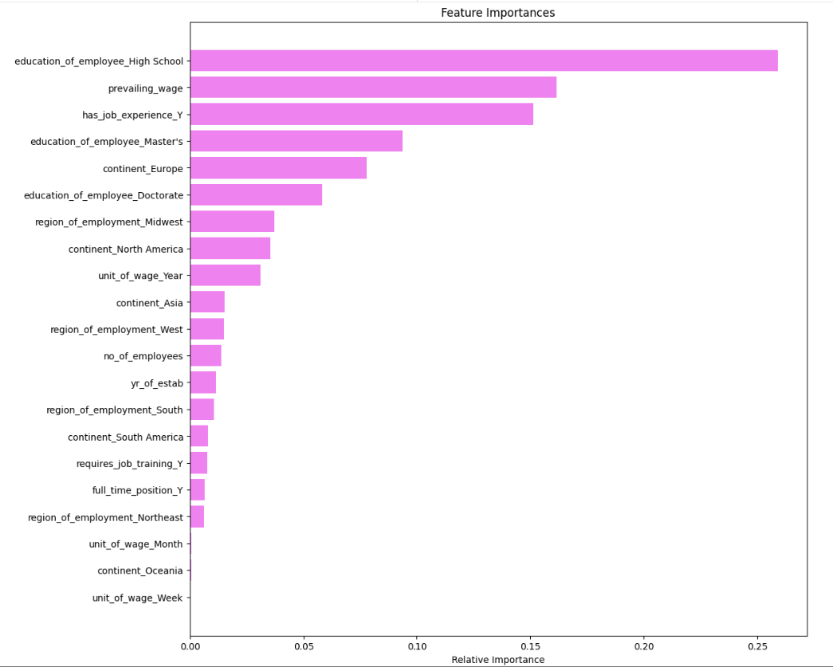
Important Features
Primary predictors for Application outcomes:
Education level - Higher education levels show positive correlation with approvals.
Prevailing wages - A positive predictor, higher wages show a strong correlate with approval outcomes
Prior Job Experience - Employees with prior job experience have higher chance of receiving approvals
Continent - European region has higher approvals rate, followed by Africa, Asia, North America and South America regions.

Slide 27
APPENDIX

Slide 28
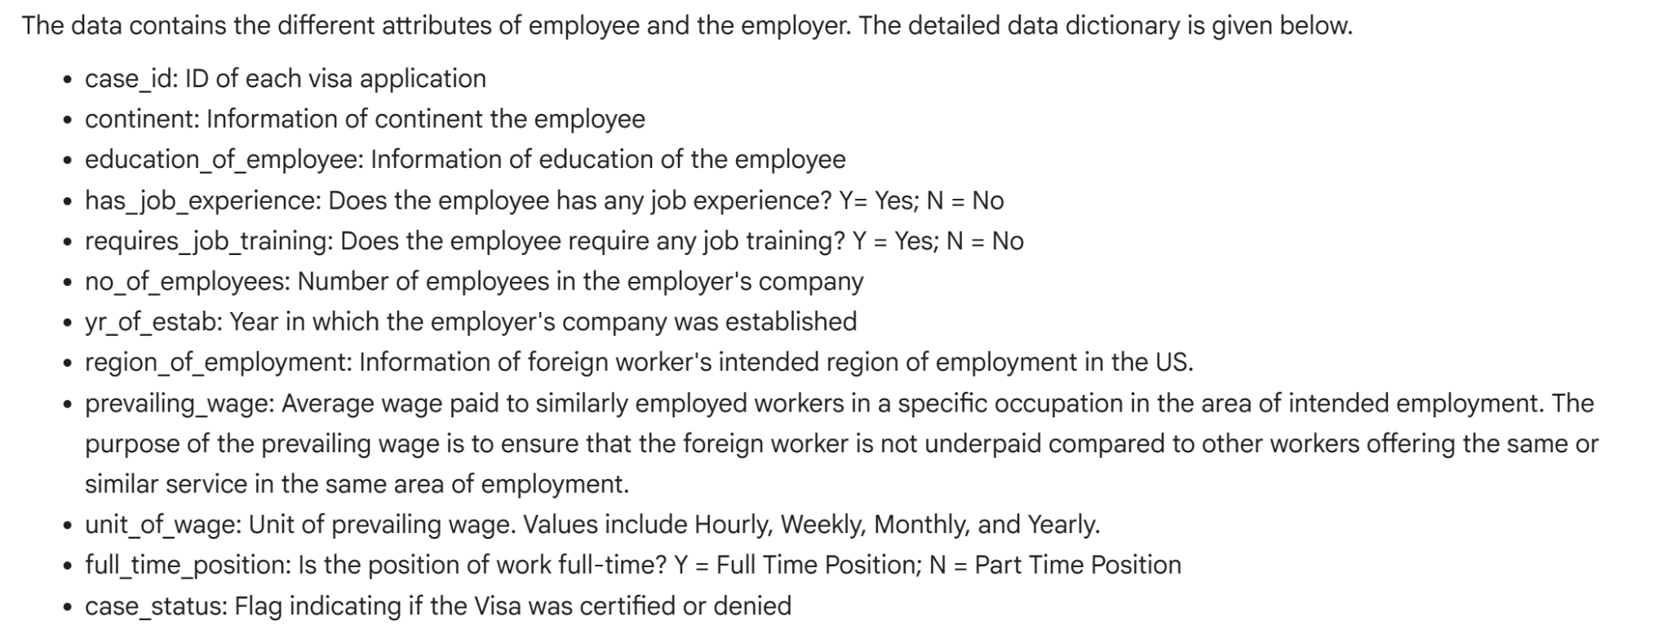
Data Background and Contents

Slide 29
Model Performance Summary and Final Model Selection
Compare the performance of the tuned models
Overview of final ML model and its parameters
Comment on the performance of the final model
Summary of most important factors used by the ML model for prediction
Note: You can use more than one slide if needed

Slide 30
Model Building - Original Data
Five Classifier models with default parameters were developed to establish the baseline performance.
Model | F1 Score |  | Observation
 | Training | Validation
Bagging Classifier | 0.9891 | 0.7736 | Overfitting
Random Forest Classifier | 1.0 | 0.8049 | Overfitting
AdaBoost Classifier | 0.8204 | 0.8180 | Generalizing well.
Gradient Boost Classifier | 0.8291 | 0.8266 | Generalizing well.
XGBoost Classifier | 0.8963 | 0.8079 | Overfitting
AdaBoost and Gradient Boost Classifiers are generalizing well, with a fairly good F1 score of 0.82.
Bagging, Random Forest and XGBoost classifier models did well on training data, but not so good on validation data indicating a overfit scenario.

Slide 31
Model Building - Oversampled Data
SMOTE ( Synthetic Minority Oversampling Technique) is used to address the imbalance between the output classes. The algorithm uses K-nearest neighbors approach to generate the minority class data.
Model | F1 Score |  | Observation
 | Training | Validation
Bagging Classifier | 0.9875 | 0.7665 | Overfitting
Random Forest Classifier | 0.9999 | 0.7965 | Overfitting
AdaBoost Classifier | 0.8005 | 0.8195 | Generalizing well.
Gradient Boost Classifier | 0.8072 | 0.8173 | Generalizing well.
XGBoost Classifier | 0.8708 | 0.8129 | Overfitting
AdaBoost and Gradient Boost Classifiers are generalizing well, with a decent F1 score of 0.81, but it is slightly lower than without Class Oversampling.

Slide 32
Model Building - Undersampled Data
RandomUnderSampler method is used to undersample the training data.
Model | F1 Score |  | Observation
 | Training | Validation
Bagging Classifier | 0.9803 | 0.7057 | Overfitting
Random Forest Classifier | 1.0 | 0.7417 | Overfitting
AdaBoost Classifier | 0.7015 | 0.76599 | Underfitting
Gradient Boost Classifier | 0.7281 | 0.7765 | Underfitting
XGBoost Classifier | 0.8720 | 0.7459 | Overfitting
AdaBoost and Gradient Boost Classifiers did better on validation data, but are making lot more mistakes in prediction.
Bagging, Random Forest and XGBoost classifiers did well on training, but performed poorly on validation data indicating the overfitting.

Slide 33
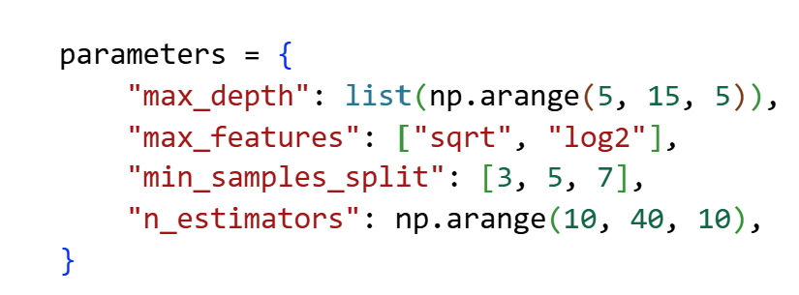
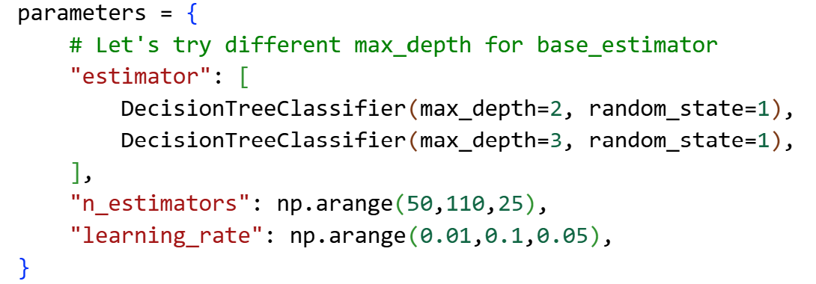
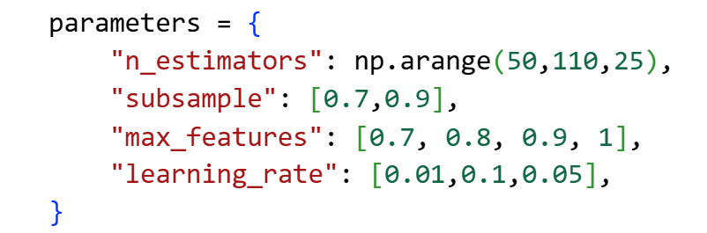
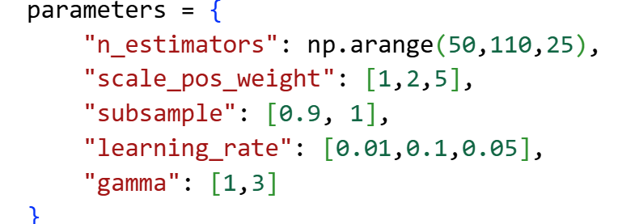
Model Improvement - Hyperparameter Tuning
The goal of Hyperparameter tuning is to find the optimal configuration to maximize the model performance.
The tuning process should balance between the performance and execution time. Overturning not only takes long execution time, also could lead to overfitting.
The parameters vary based on the model, the following parameters were tuned.
Random Forest Classifier
AdaBoost Classifier
Gradient Boost Classifier
XGBoost Classifier
Gradient Boost Classifier, XGBoost Classifier and Random Forest Classifier models performed relatively better.
Overall Gradient Boost Classifier has the best F1 score with identical performance between the Training, Validation and Test data indicating good generalizaiton

Slide 34
Model Performance - Training, Validation and Test data

Slide 35
Slide Header
Please add any other pointers (if needed)

